Slide 1

CMR Technical Campus
Automatic HTML Code Generation from Mock-up Images Using Machine Learning Techniques
PRESENTED BY :
M chandanA (197R1A0536)
PROJECT GUIDE :
SANJANA NAZARE (ASST PROFESSOR)

Slide 2
ABSTRACT
The design cycle for a web site starts with creating mock-ups for individual web pages either by hand or using graphic design and specialized mock-up creation tools. The mockup is then converted into structured HTML or similar markup code by software engineers. This process is usually repeated many more times until the desired template is created. In this study, our aim is to automate the code generation process from hand-drawn mock-ups. Hand drawn mock-ups are processed using computer vision techniques and subsequently some deep learning methods are used to implement the proposed system. Our system achieves 96% method accuracy and 73% validation accuracy.
Index Terms—Object detection, object recognition, convolutional neural network, deep learning, automatic code generation, HTML

Slide 3
EXISTING SYSTEM
This study, an algorithm has been developed to automatically generate the HTML code for hand-drawn mock-up of a web page. It is aimed to recognize the components created in the mock-up drawing and to encode them according to the web page hierarchy. A public dataset of hand-drawn images of web sites obtained from Microsoft AI Labs’ GitHub page is used to train and verify the proposed scheme.
The images on the dataset are processed using computer vision techniques and a deep neural network model involving convolutional neural networks is used to train the data. Afterwards a structured HTML code is obtained. Our model achieves 96% method accuracy and 73% validation accuracy.

Slide 4
PROPOSED SYSTEM
CONVOLUTIONAL NEURAL NETWORK
A Convolutional Neural Network (ConvNet/CNN) is a Deep Learning algorithm which can take in an input image, assign importance (learnable weights and biases) to various aspects/objects in the image and be able to differentiate one from the other. The pre-processing required in a ConvNet is much lower as compared to other classification algorithms. While in primitive methods filters are hand-engineered, with enough training, ConvNets have the ability to learn these filters/characteristics.
The architecture of a ConvNet is analogous to that of the connectivity pattern of Neurons in the Human Brain and was inspired by the organization of the Visual Cortex. Individual neurons respond to stimuli only in a restricted region of the visual field known as the Receptive Field. A collection of such fields overlap to cover the entire visual area.

Slide 5
ADVANTAGES AND DISADVANTAGES
ADVANTAGES | DISADVANTAGES
PRODUCTIVITY- by writing less code, Especially repetitive code, you save time MAINTAINABILITY- less written code Means fewer bugs and less maintenance QUALITY- Homogenizing the code Increases overall quality especially with a Team of developers with different levels Of experience | Input should be an image Attractive designs in input image are difficult to detect and create. The system may not able to detect all GUI components

Slide 6
REQUIREMENT SPECIFICATION:
Software Requirements - For developing the application the following are the Software Requirements
Python , MySql
Hardware Requirements
For developing the application the following are the Hardware Requirements:
Processor: Pentium IV or higher
RAM: 4 GB
Space on Hard Disk: minimum 4GB

Slide 7
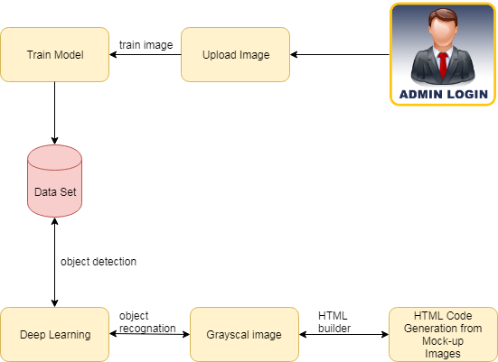
ARCHITECTURE:

Slide 8
MODULES
Upload Datasets Files
Admins are allowed to upload the CSV files with the tags given. Once the file is uploaded, In SQL the Object Relational Mapper is introduced and fully described. If you want to work with higher-level SQL which is constructed automatically Create Engine stored the Data Base.
Object Detection and Cropping
After reading the input file, it is converted to gray scale format. Then, Gaussian Blur was applied 2 times to them with 3x3 rectangle kernel. After the threshold process was carried out, rectangle were drawn by applying the contour detection algorithm to determine the objects by applying morphological transformations. In this way, the components in the input image have been detected. The detected components were cropped to be transferred to the CNN model.

Slide 9
MODULES
Object Recognition
As mentioned , a dataset before it consists of four different types of components such as textbox, dropdown, button and checkbox. After the stage of training the model, the loss function was trained for 200 epochs using Binary Cross entropy and RMS Prop algorithms by setting the batch size to 64. Afterwards, component recognition process was carried out by giving the cropped components that came from the previous stage as input.
HTML Builder
Recognized components were successfully translated into HTML code via the bootstrap framework. It was performed with the help of the coordinates from the result of the contour finding algorithm. demonstrates the latest output that obtained from a browser when the input image is the first one of the images

Slide 10
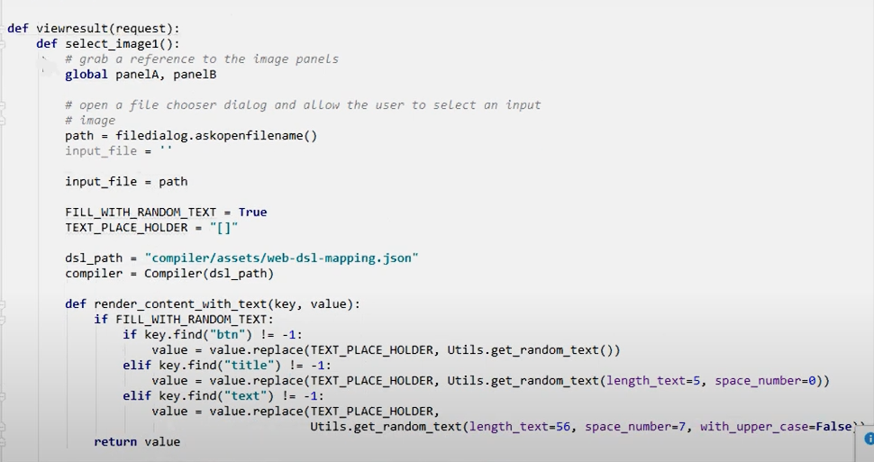
SAMPLE CODE

Slide 11
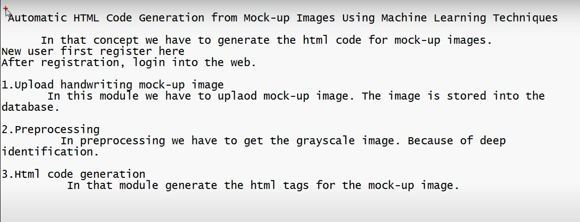
PROCESSING DATA

Slide 12
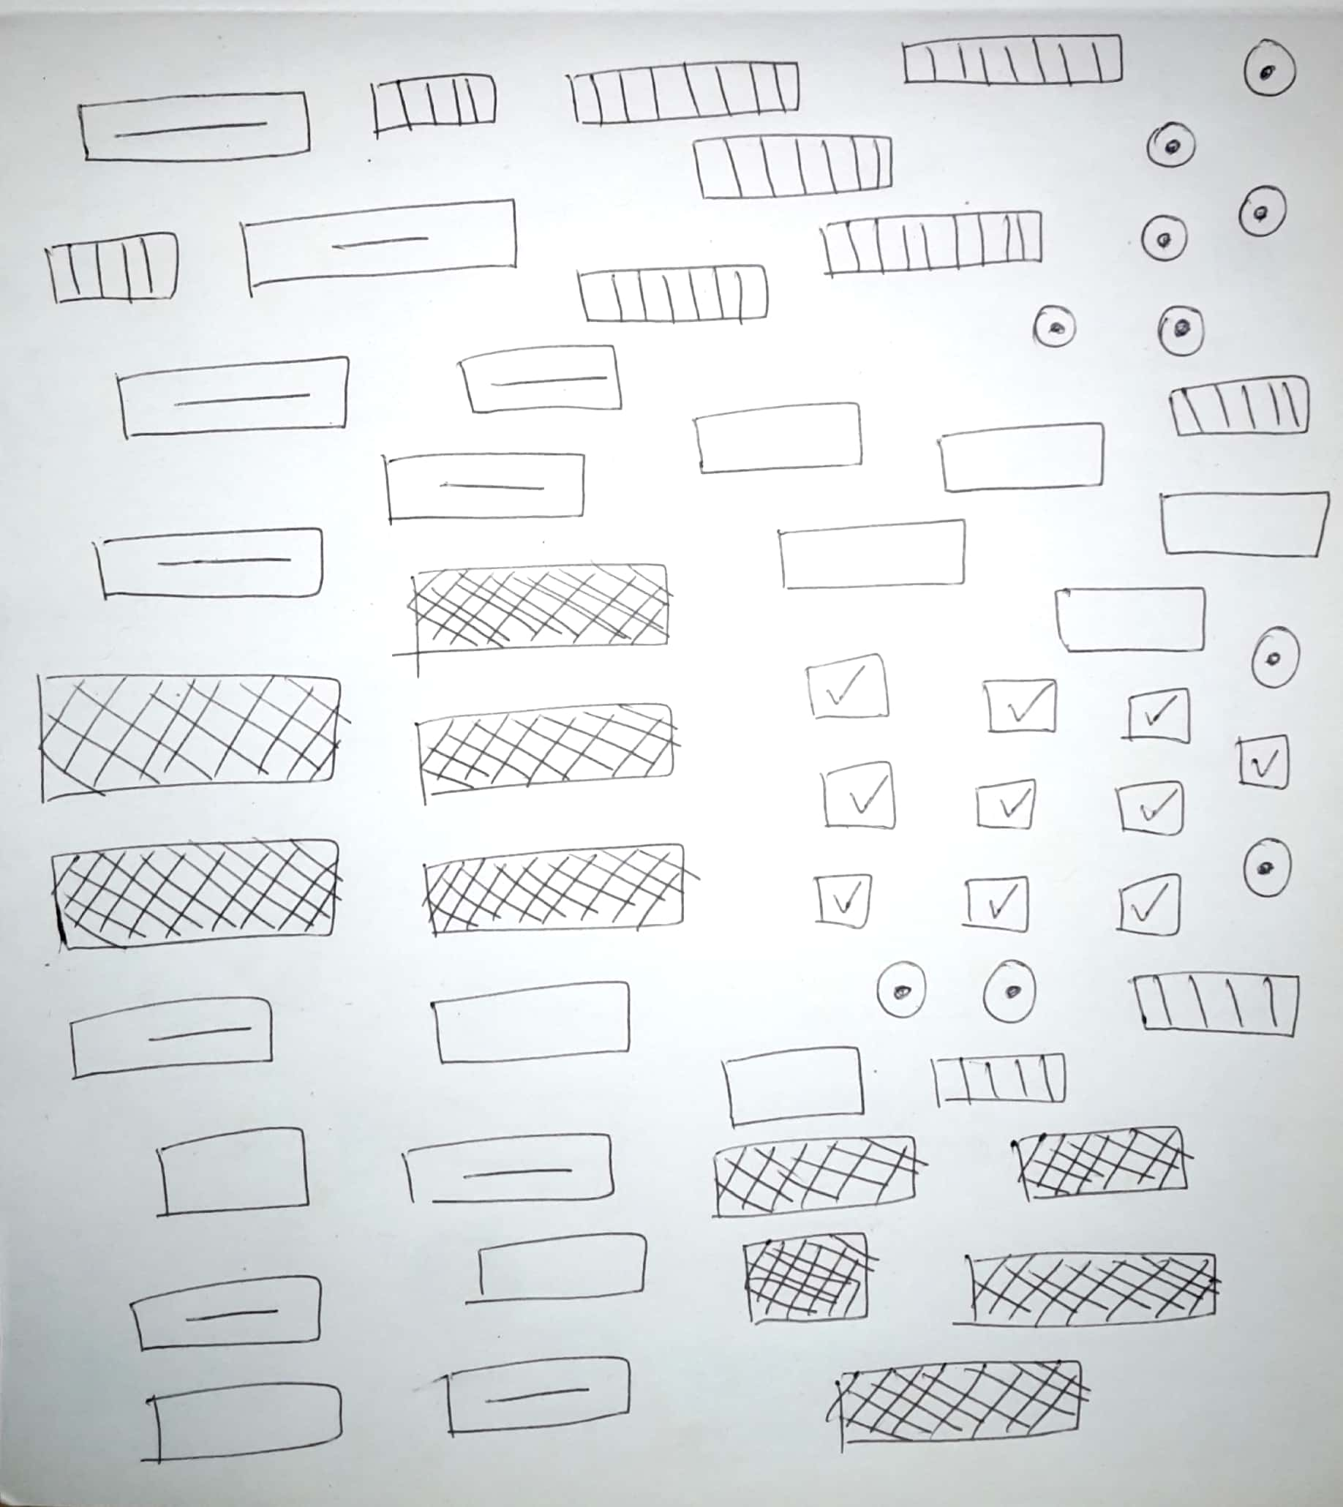

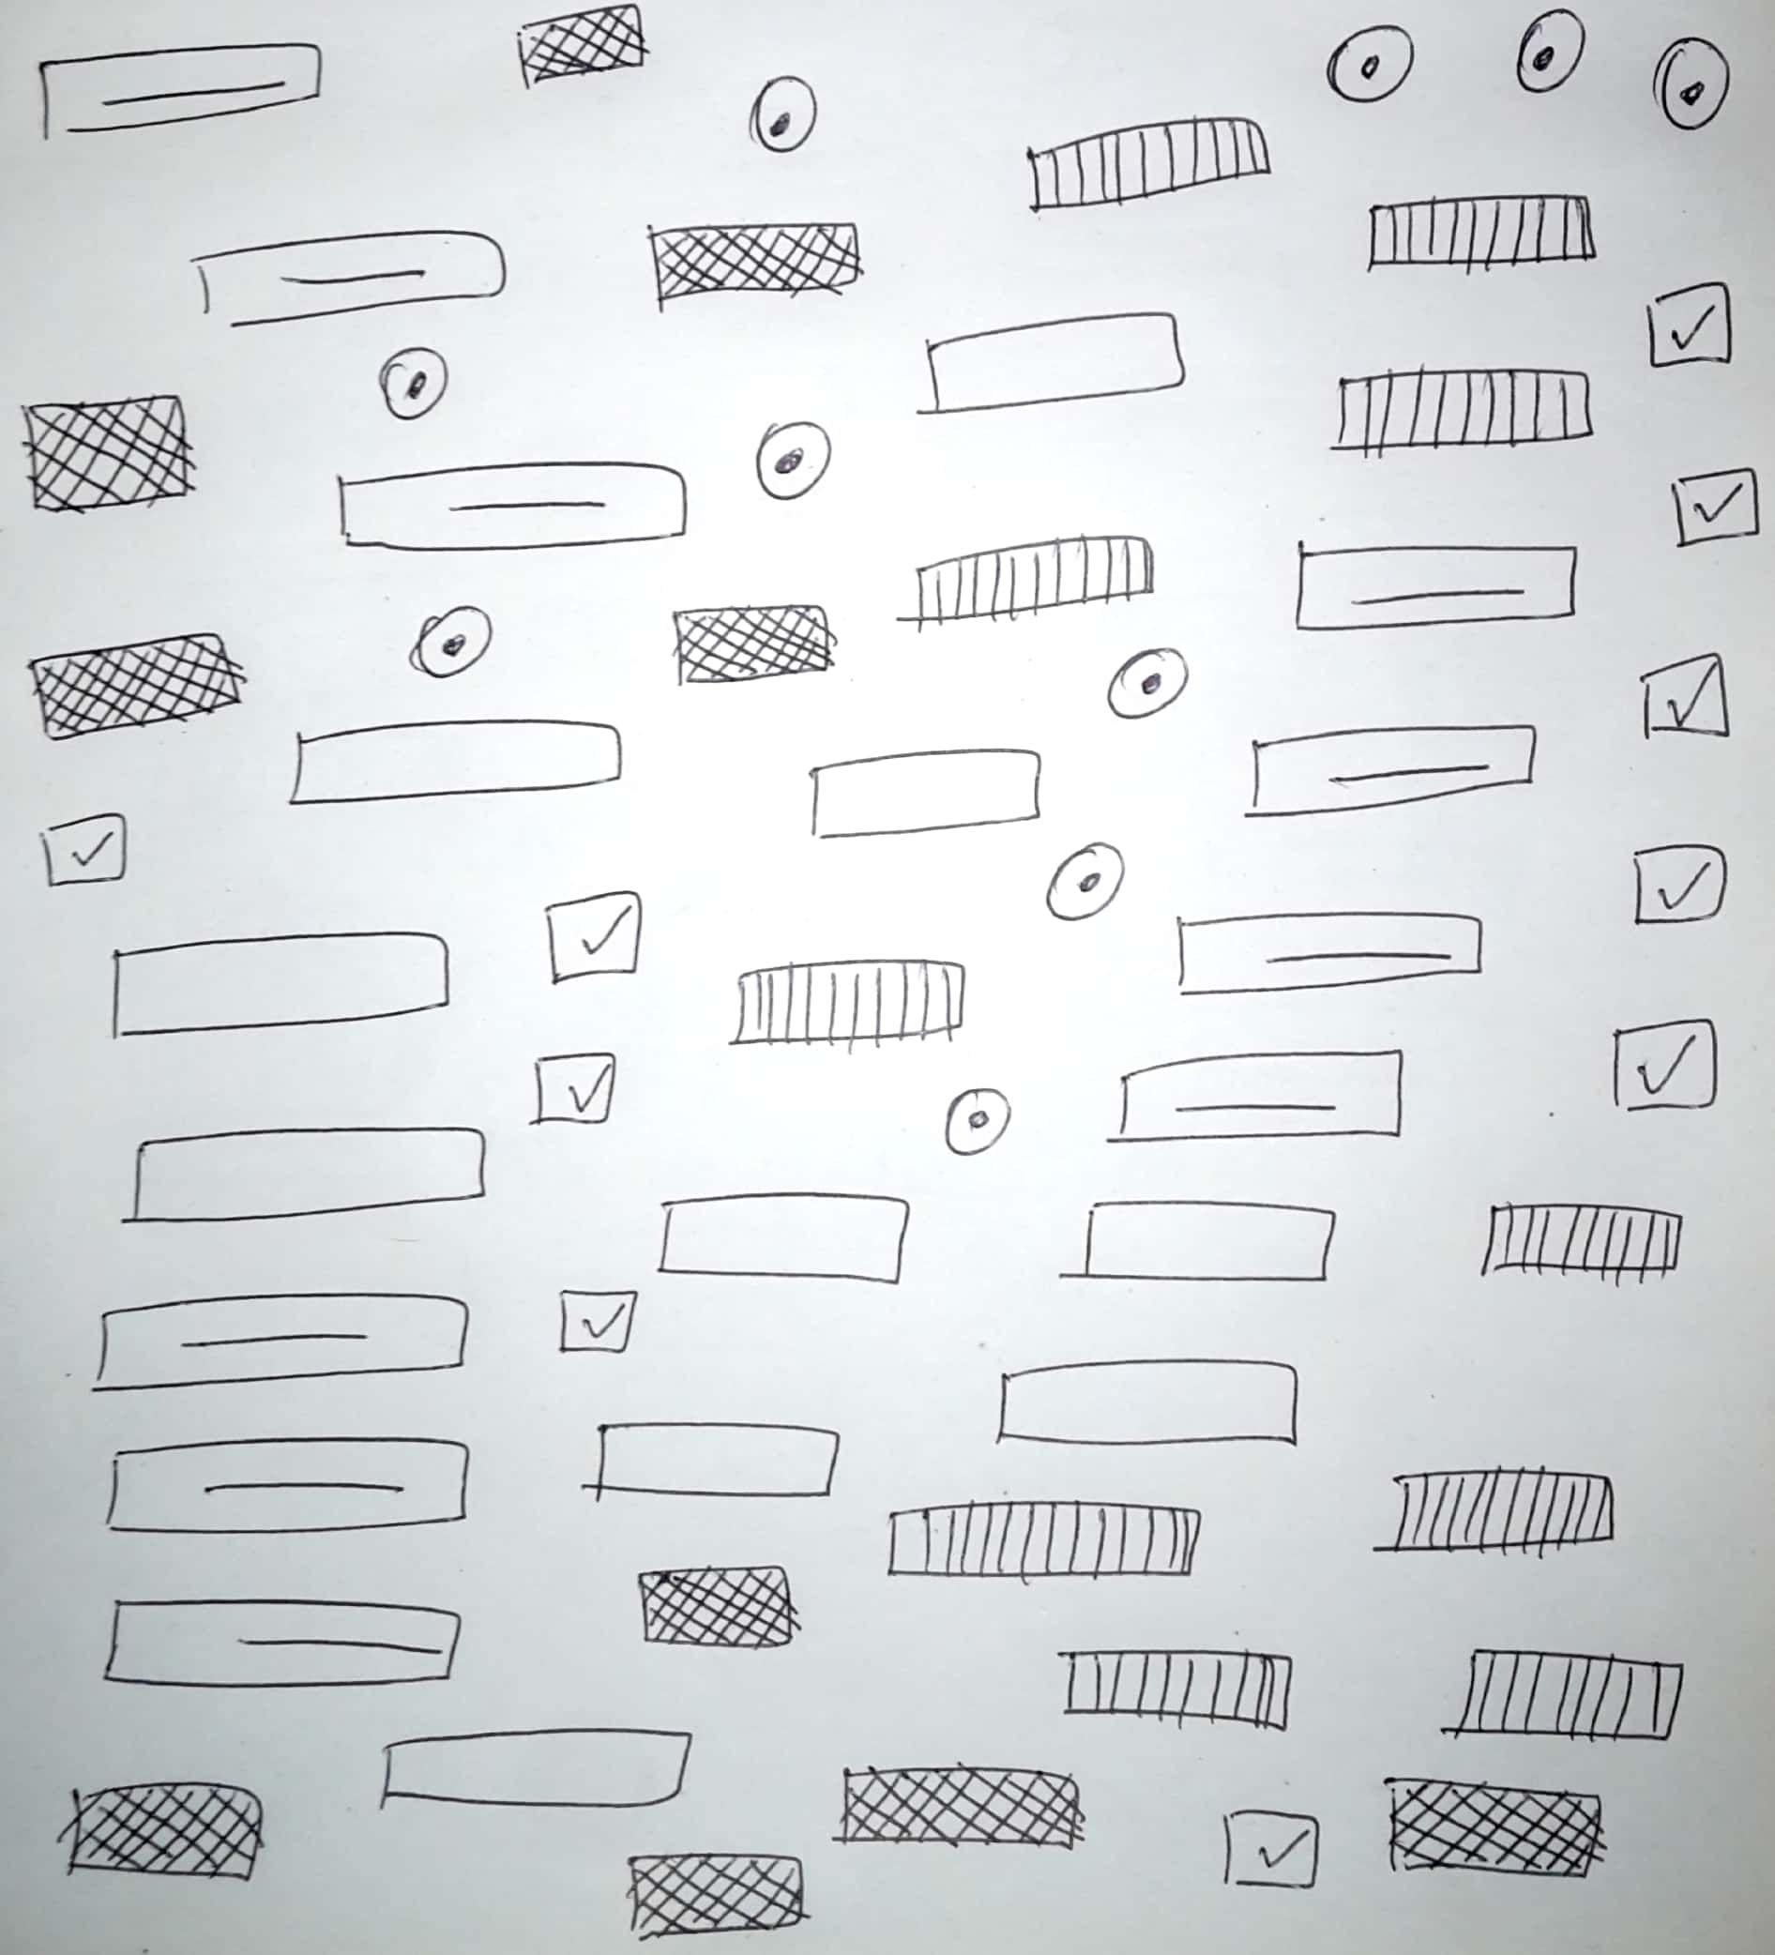
Mockup images

Slide 13
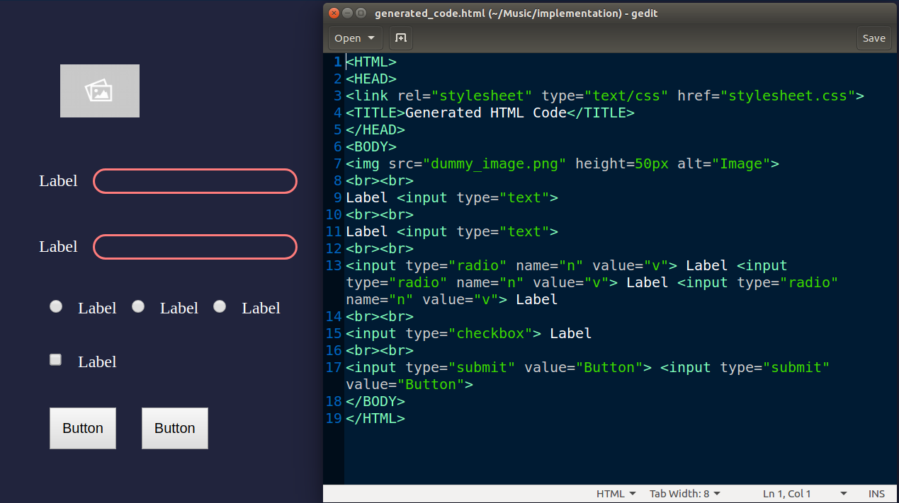
OUTPUTS/ RESULTS

Slide 14
CONCLUSION
Website is an important part in this growing world of Technology as it is useful for product marketing and advertising purpose. Hence, it is important to build a website which will attract large number of users. In existing system building a website is a time consuming process.
The proposed system takes hand drawn images of web form and convert it into HTML code. Hence, the system will consume less time and resources as compared to existing system.

Slide 15
FUTURE ENHANCEMENT
In creation of website the cost labor and minimum time can be reduced by converting web page mock ups to their markup code. Also, by using this automatic HTML code generator it is easy to make modification in web page creation with the least cost and minimum time. This can fasten the deployment process of website. The purpose of this study, is to create automatic HTML code from handdrawn mock-ups was successful. For this study, we have designed four consecutive principles object reorganization, object cropping, object detection and HTML building. A CNN architecture was also used in object reorganization stage. As a result, after the training phase of 200 epoch, accuracy and validation accuracy were obtained as 96% and 73%, respectively.

Slide 16
REFERENCES
[1] Sketch2code. Microsoft AI Labs. [Online]. Available: https://github.com/
[2] T. A. Nguyen and C. Csallner, “Reverse Engineering Mobile Application User Interfaces with REMAUI (T),” in 2015 30th IEEE/ACM International Conference on Automated Software Engineering (ASE). IEEE, nov 2015, pp. 248–259. [Online]. Available: http: //ieeexplore.ieee.org/document/7372013/
[3] S. Natarajan and C. Csallner, “P2A: A Tool for Converting Pixels to Animated Mobile Application User Interfaces,” Proceedings of the 5th International Conference on Mobile Software Engineering and Systems - MOBILESoft 18, pp. 224–235, 2018. [Online]. Available: http://dl.acm.org/citation.cfm?doid=3197231.3197249
[4] T. Beltramelli, “pix2code: Generating code from a graphical user interface screenshot,” CoRR, vol. abs/1705.07962, 2017. [Online]. Available: http://arxiv.org/abs/1705.07962

Slide 17
GITHUB LINK
https://github.com/mohak1/Automatic-HTML-Code-Generation-from-Images

